Slide 1
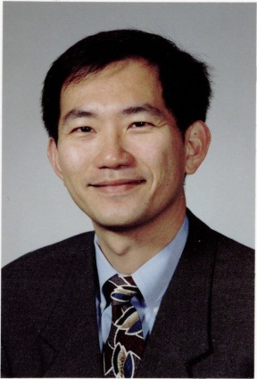

Chapter 1 Trajectory Preprocessing
Wang-Chien Lee
Pennsylvania State University
University Park, PA USA
John Krumm
Microsoft Research
Redmond, WA USA

Slide 2
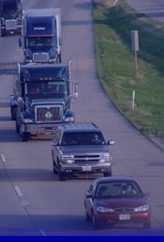
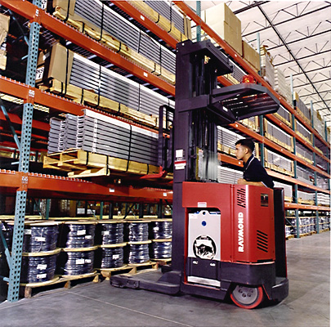
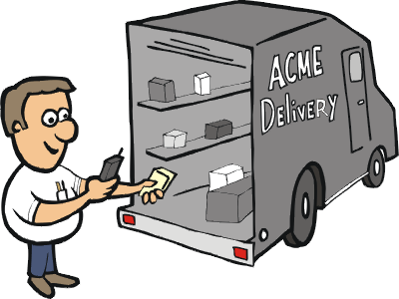
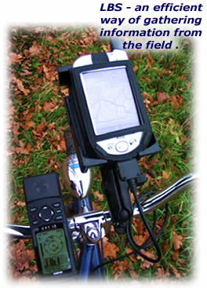
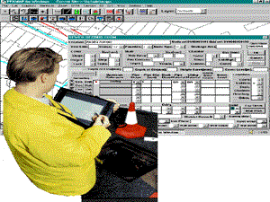
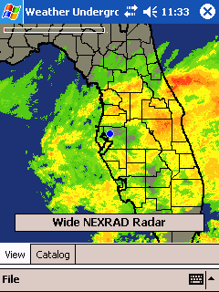


Location-Based Services
Traffic info
Logistics
Mobile Commerce
Navigation
Local weather
Geographical Information
System (GIS)
Emergency service
Tracking
Notes:
LBSs support many important applications in the pervasive computing era.

Slide 3
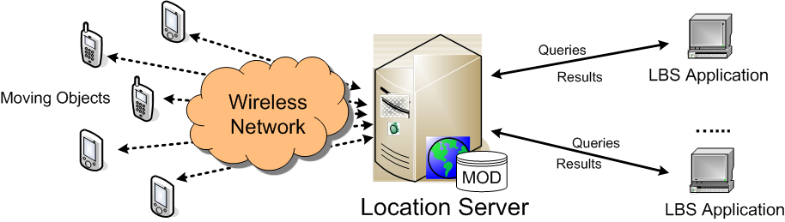
System Model for LBSs
The locations of tracked moving objects are reported to the location server via wireless communications.
The LBS applications submit queries to the server to retrieve moving object data for analysis or other application needs.
Notes:
A high-level system model for typical location-based services.

Slide 4
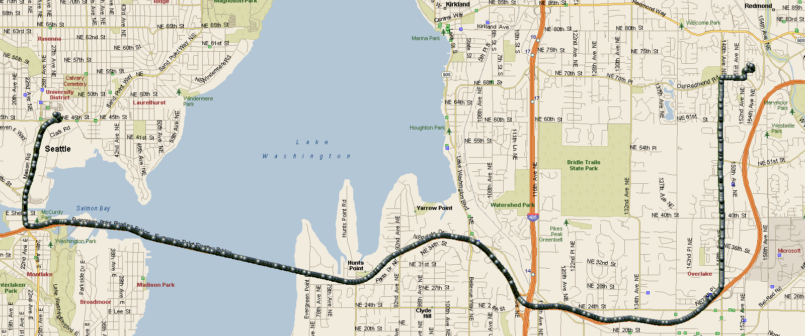
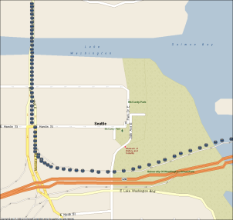
Trajectories
{< x₁, y₁, t₁>, < x₂, y₂, t₂>, ..., < x_{N}, y_{N}, t_{N}>}
Positioning technologies
Global positioning system (GPS)
Network-based (e.g., using cellular or wifi access points)
Dead-Reckoning (for estimation)
DR is the process of calculating one's current position by using a previously
Determined position, or fix,

Slide 5
Mobile Object Databases
Research communities have made tremendous research effort to support LBSs.
E.g., Mobile object databases (MODs)
In addition to conventional search functions of moving objects, many LBS applications need to analyze and mine various moving patterns and phenomenon of tracked objects.
Trajectory Management: trajectories of moving objects, i.e., their geographical-temporal traces, are often treated as first-class citizens in MODs.

Slide 6
Trajectory Preprocessing
Problems to solve with trajectories
Lots of trajectories → lots of data
Noise complicates analysis and inference
Employ the data reduction and filtering techniques
Specialized data compression for trajectories
Principled filtering techniques
Notes:
Very difficult and expensive to capture the accurate and complete trajectory of a moving object due to the inherent limitations of data acquisition and storage mechanisms.

Slide 7
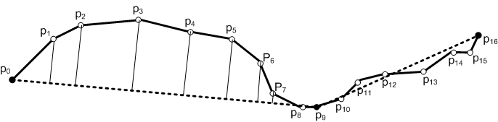
Part 1 - Compression

Slide 8

Performance Metrics
Trajectory data reduction techniques aims to reduce trajectory size w/o compromising much precision.
Performance Metrics
Processing time
Compression Rate
Error Measure
The distance between a location on the original trajectory and the corresponding estimated location on the approximated trajectory is used to measure the error introduced by data reduction.
Examples are Perpendicular Euclidean Distance or Time Synchronized Euclidean Distance.

Slide 9
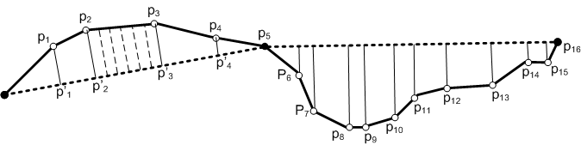
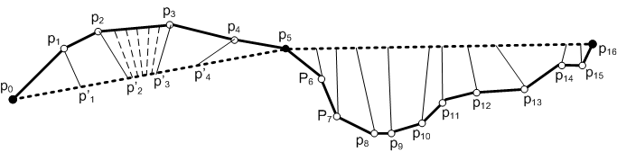
Illustration of Error Measures
Perpendicular Euclidean Distance
Time Synchronized Euclidean Distance
Notes:
Perpendicular Euclidean Distance is based on projection of the location points on original trajectory to the approximate trajectory. Time Synchronized Euclidean Distance assumes object moving in constant speed on segments and thus synchronizes the original points with the mapped points by time. Area between the two trajectory can also be used as the error measure or by increasing the measure points (e.g., add some pseudo points in segments --- see those within p2p3 in the figures.

Slide 10
Trajectory Data Reduction
Classification of Data Reduction Techniques.
Batched Compression:
Collect full set of location points and then compress the data set for transmission to the location server.
Applications: content sharing sites such as Everytrail and Bikely.
Techniques include Douglas-Peucker Algorithm, top-down time-ratio (TD-TR), and Bellman's algorithm.
On-line Data Reduction
Selective on-line updates of the locations based on specified precision requirements.
Applications: traffic monitoring and fleet management.
Techniques include Reservoir Sampling, Sliding Window, and Open Window.
Notes:
A natural complement to the top-down Douglas-Peucker algorithm is the \emph{bottom-up} algorithm

Slide 11
Batch Compression - Douglas-Peucker (DP) Algorithm
Preserve directional trends in the approximated trajectory using the perpendicular Euclidean distance as the error measure.
Replace the original trajectory by an approximate line segment.
If the replacement does not meet the specified error requirement, it recursively partitions the original problem into two subproblems by selecting the location point contributing the most errors as the split point.
This process continues until the error between the approximated trajectory and the original trajectory is below the specified error threshold.

Slide 12
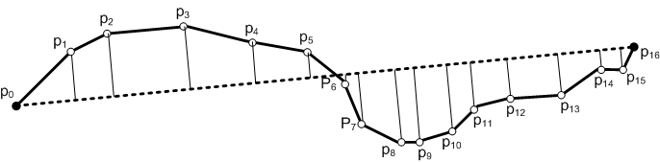
Illustration of DP Algorithm
Split at the point with most error.
Repeat until all the errors < given threshold

Slide 13
Batch Compression - Top-Down Time-Ratio (TDTR) and Bellman Algorithms
DP uses perpendicular Euclidean distance as the error measure. Also, it’s heuristic based, i.e., no guarantee that the selected split points are the best choice.
TDTR uses time synchronized Euclidean distance as the error measure to take into account the geometric and temporal properties of object movements.
Bellman Algorithm employs dynamic programming technique to ensure that the approximated trajectory is optimal
Its computational cost is high.

Slide 14
Joke
The one about the guy who joins a monastery

Slide 15
Reservoir Sampling
Generate an approximated trajectory of size R.
Maintain a reservoir of size R.
When a location point is acquired, decide whether to insert it into the reservoir. Once a location point is discarded, cannot get it back into the reservoir.
When the k^{th} location point is acquired (k > R), randomly decides, with a probability of R/k, whether to keep this location point or not.
If the decision is positive, one of the R existing location points in the reservoir is discarded randomly to make space for the new location point.
the reservoir algorithm always maintains a uniform sample of the evolving trajectory without even knowing the eventual trajectory size.

Slide 16
On-line Compression – Sliding Window
Fit the location points in a growing sliding window with a valid line segment and continue to grow the sliding window until the approximation error exceeds some error bound.
First initialize the first location point of a trajectory as the anchor point p_{a} and then starts to grow the sliding window
When a new location point p_{i} is added to the sliding window, the line segment p_{a} p_{i} is used to fit all the location points within the sliding window.
As long as the distance errors against the line segment p_{a} p_{i} are smaller than the user-specified error threshold, the sliding window continues to grow. Otherwise, the line segment p_{a} p_{i-1} is included as part of the approximated trajectory and p_{i} is set as the new anchor point.
The algorithm continues until all the location points in the original trajectory are visited.

Slide 17
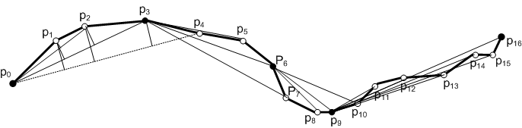
Sliding Window - Illustration
While the sliding window grows from {p₀} to {p₀, p₁, p₂, p₃}, all the errors between fitting line segments and the original trajectory are not greater than the specified error threshold.
When p₄ is included, the error for p₂ exceeds the threshold, so p₀p₃ is included in the approximate trajectory and p₃ is set as the anchor to continue.

Slide 18
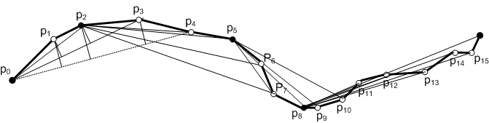
Open Window
Different from the sliding window, choose location points with the highest error in the sliding window as the closing point of the approximating line segment as well as the new anchor point.
When p₄ is included, the error for p₂ exceeds the threshold, so p₀p₂ is included in the approximate trajectory and p₂ is set as the anchor to continue.

Slide 19
Part 1 Summary
Trajectory Data Compression
Batch
Douglas-Peucker (DP)
Top-Down Time Ratio (TDTR) – time included
Bellman – dynamic programming
On-line
Sliding window
Open window (variation of sliding window)

Slide 20
Part 2 - Filtering
Goals
Smooth noise & outliers
Infer higher level values (e.g. speed)
Techniques
Mean and median
Kalman filter
Particle filter

Slide 21
Running Example
Track a moving person in (x,y)
1075 (x,y) measurements
Δ = 1 second
Manually added outliers
Notation
measurement vector
actual location
noise
zero mean
standard deviation = ~4 meters

Slide 22
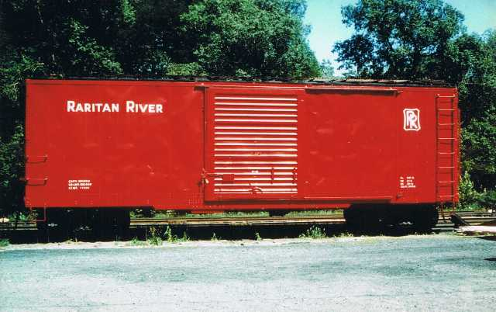
Mean Filter
Also called “moving average” and “box car filter”
Apply to x and y measurements separately
Filtered version of this point is mean of points in solid box
z_{x}
t
“Causal” filter because it doesn’t look into future
Causes lag when values change sharply
Help fix with decaying weights, e.g.
Sensitive to outliers, i.e. one really bad point can cause mean to take on any value
Simple and effective (I will not vote to reject your paper if you use this technique)

Slide 23
Mean Filter
outlier
10 points in each mean
Outlier has noticeable impact
If only there were some convenient way to fix this …

Slide 24
Median Filter
Filtered version of this point is mean median of points in solid box
Insensitive to value of, e.g., this point
z_{x}
t
Median is way less sensitive to outliners than mean
median (1, 3, 4, 7, 1 x 10¹⁰) = 4
mean (1, 3, 4, 7, 1 x 10¹⁰) ≈ 2 x 10⁹

Slide 25
Median Filter
outlier
10 points in each median
Outlier has noticeable less impact

Slide 26
Joke
The one about the statisticians who go hunting

Slide 27
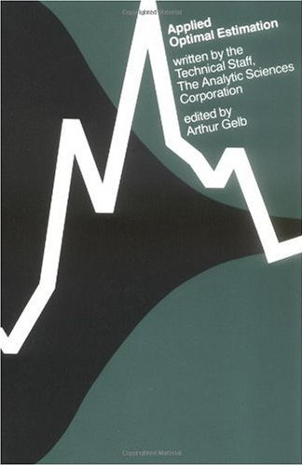
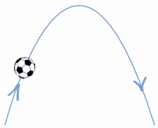
Kalman Filter
Assumed trajectory is parabolic
Mean and median filters assume smoothness
Kalman filter adds assumption about trajectory
My favorite book on Kalman filtering
Weight data against assumptions about system’s dynamics
Big difference #1: Kalman filter includes (helpful) assumptions about behavior of measured process
dynamics
data

Slide 28
Kalman Filter
Kalman filter separates measured variables from state variables
Running example: measure (x,y) coordinates (noisy)
Measure:
Running example: estimate location and velocity (☺!)
Infer state:
Big difference #2: Kalman filter can include state variables that are not measured directly

Slide 29
Kalman Filter Measurements
Measurement vector is related to state vector by a matrix multiplication plus noise.
Running example:
In this case, measurements are just noisy copies of actual location
Makes sensor noise explicit, e.g. GPS has σ of around 4 meters

Slide 30
Kalman Filter Dynamics
Insert a bias for how we think system will change through time
location is standard straight-line motion
velocity changes randomly (because we don’t have any idea what it actually does)

Slide 31
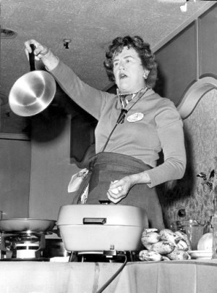
Kalman Filter Ingredients
H matrix: gives measurements for given state
Measurement noise: sensor noise
φ matrix: gives time dynamics of state
Process noise: uncertainty in dynamics model

Slide 32
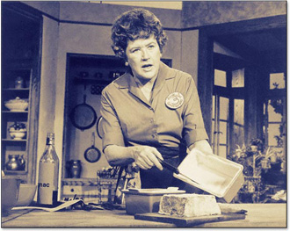
Kalman Filter Recipe
Just plug in measurements and go
Recursive filter – current time step uses state and error estimates from previous time step
Big difference #3: Kalman filter gives uncertainty estimate in the form of a Gaussian covariance matrix

Slide 33
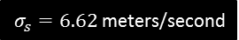
Kalman Filter
Velocity model:
Hard to pick process noise σ_{s}
Process noise models our uncertainty in system dynamics
Here it accounts for fact that motion is not a straight line
“Tuning” σ_{s} (by trying a bunch of values) gives better result

Slide 34
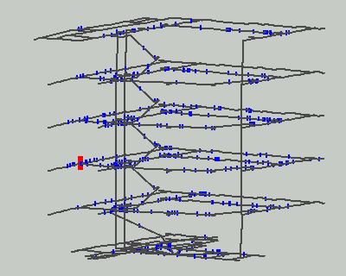
Particle Filter
Dieter Fox et al.
WiFi tracking in a multi-floor building
Multiple “particles” as hypotheses
Particles move based on probabilistic motion model
Particles live or die based on how well they match sensor data

Slide 35
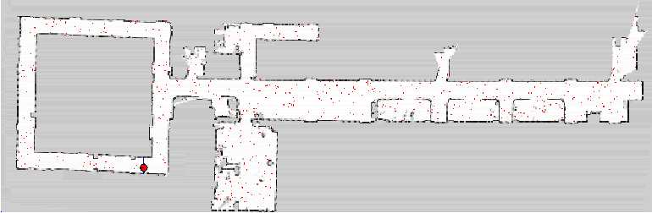
Particle Filter
Dieter Fox et al.
Allows multi-modal uncertainty (Kalman is unimodal Gaussian)
Allows continuous and discrete state variables (e.g. 3rd floor)
Allows rich dynamic model (e.g. must follow floor plan)
Can be slow, especially if state vector dimension is too large (e.g. (x, y, identity, activity, next activity, emotional state, …) )

Slide 36
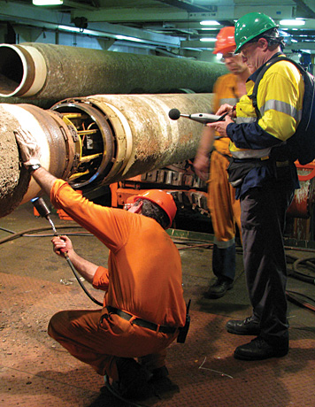
Particle Filter Ingredients
z = measurement, x = state, not necessarily same
Probability distribution of a measurement given actual value
Can be anything, not just Gaussian like Kalman
But we use Gaussian for running example, just like Kalman
E.g. measured speed (in z) will be slower if emotional state (in x) is “tired”
For running example, measurement is noisy version of actual value

Slide 37
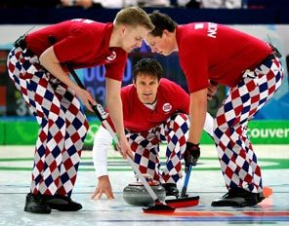
Particle Filter Ingredients
Probabilistic dynamics, how state changes through time
Can be anything, e.g.
Tend to go slower up hills
Avoid left turns
Attracted to Scandinavian people
Closed form not necessary
Just need a dynamic simulation with a noise component
But we use Gaussian for running example, just like Kalman
x_{i}
random vector
x_{i-1}

Slide 38
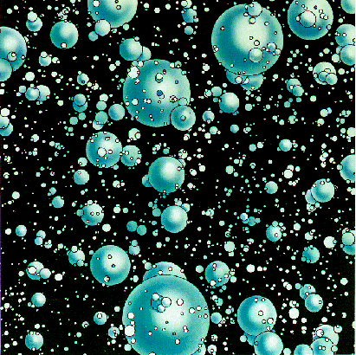
Particle Filter Algorithm
Start with N instances of state vector x_{i}^{(j)} , i = 0, j = 1 … N
i = i+1
Take new measurement z_{i}
Propagate particles forward in time with p(x_{i}|x_{i-1}), i.e. generate new, random hypotheses
Compute importance weights w_{i}^{(j)} = p(z_{i}|x_{i}^{(j)}), i.e. how well does measurement support hypothesis?
Normalize importance weights so they sum to 1.0
Randomly pick new particles based on importance weights
Goto 1
Compute state estimate
Weighted mean (assumes unimodal)
Median

Slide 39
Particle Filter
Dieter Fox et al.
WiFi tracking in a multi-floor building
Multiple “particles” as hypotheses
Particles move based on probabilistic motion model
Particles live or die based on how well they match sensor data

Slide 40
Particle Filter Running Example
Measurement model reflects true, simulated measurement noise. Same as Kalman in this case.
Straight line motion with random velocity change. Same as Kalman in this case.
location is standard straight-line motion
velocity changes randomly (because we don’t have any idea what it actually does)
Sometimes increasing the number of particles helps

Slide 41
Part 2 Summary
Measurement assumptions
Mean and median filters
Kalman filter
Particle filter

Slide 42
End

